Slide 1
Automating Chest X-ray interpretation with AI Using the MIMIC-CXR dataset
Team 6:
Preston Lim, Tiancheng Ma, Sheryl Ng Hui Xian, Idauli Tamarin, Zhang Lulu, Zhong Zijie

Slide 2

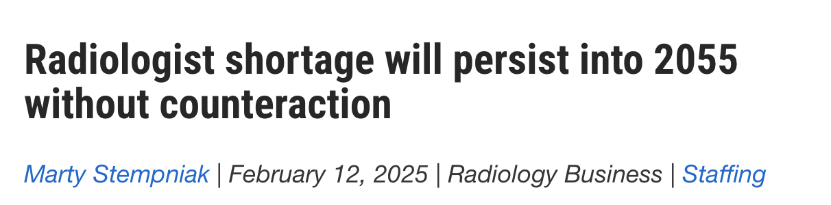
Radiologists are in shortage globally

Slide 3
What if we could empower non-radiologists to interpret diagnostic imaging with AI?

Slide 4
Approach: Predict presence of common clinical findings in chest radiographs
Data
45,628 chest X-ray embeddings from the MIMIC-CXR repository
Labels for 13 clinical findings: 0 – no finding; 1 – positive finding; -1 – uncertain
Data preprocessing
Converted “uncertain” and missing values of labels to 0

Slide 5
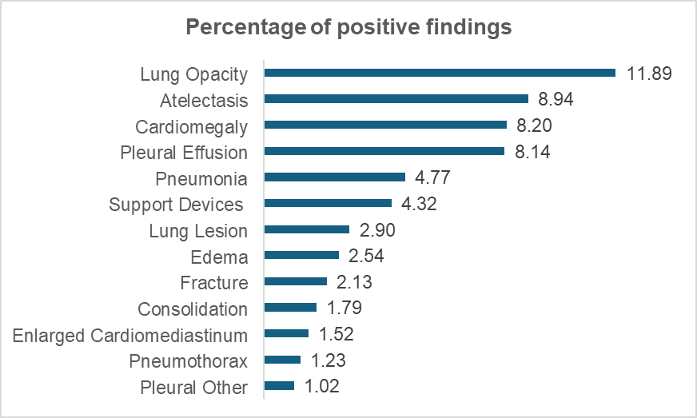
Approach: Predict presence of common clinical findings in chest radiographs

Slide 6
Models Tested
Traditional classifiers + Multi-output wrapper
Logistic regression (vanilla, L1, L2, ElasticNet)
Random forest
XGBoost
Support vector machine
Deep learning classifiers
4-layer fully connected neural network
Transformer (8 attention heads)

Slide 7
Model Training
Dataset was split into 0.5 training, 0.3 validation, 0.2 testing
Traditional classifiers
5-fold cross validation
Grid search for hyperparameter tuning for XGBoost
Randomized search for SVM
Deep learning classifiers
FCNN was trained for 20 epochs
Transformer was trained for 15 epochs
Best model:
Highest micro-averaged F1 score,
for overall prediction quality

Slide 8
Random forest and transformer models performed the best
Model | Precision | Recall | F1-Score
Logistic regression | 0.30 | 0.24 | 0.27
L1 regularization | 0.59 | 0.15 | 0.24
L2 regularization | 0.59 | 0.14 | 0.23
Elastic net | 0.60 | 0.15 | 0.24
Support vector machine | 0.61 | 0.11 | 0.18
Random forest | 0.32 | 0.52 | 0.39
xgBoost | 0.54 | 0.15 | 0.24
Fully-connected neural network | 0.15 | 0.69 | 0.24
Transformer neural network | 0.36 | 0.45 | 0.40

Slide 9
Performance improved for certain labels
 | Random forest |  |  |  | Transformer
By finding | Precision | Recall | F1-Score |  | Precision | Recall | F1-Score
Atelectasis | 0.36 | 0.57 | 0.44 |  | 0.42 | 0.45 | 0.43
Cardiomegaly | 0.39 | 0.55 | 0.45 |  | 0.36 | 0.60 | 0.45
Consolidation | 0.16 | 0.23 | 0.19 |  | 0.15 | 0.13 | 0.14
Edema | 0.31 | 0.48 | 0.38 |  | 0.33 | 0.42 | 0.37
Enlarged Cardio mediastinum | 0.08 | 0.28 | 0.13 |  | 0.06 | 0.01 | 0.02
Fracture | 0.12 | 0.14 | 0.13 |  | 0.14 | 0.02 | 0.04
Lung Lesion | 0.17 | 0.41 | 0.24 |  | 0.23 | 0.19 | 0.21
Lung Opacity | 0.33 | 0.66 | 0.44 |  | 0.34 | 0.52 | 0.41
Pleural effusion | 0.60 | 0.63 | 0.61 |  | 0.49 | 0.72 | 0.59
Pleural Other | 0.09 | 0.20 | 0.13 |  | 0.11 | 0.10 | 0.11
Pneumonia | 0.28 | 0.32 | 0.30 |  | 0.26 | 0.30 | 0.28
Pneumothorax | 0.20 | 0.23 | 0.21 |  | 0.29 | 0.18 | 0.22
Support Devices | 0.30 | 0.56 | 0.39 |  | 0.36 | 0.43 | 0.39

Slide 10
Contextualizing our findings
The best models did not perform well (F1-score<0.5)
The results are consistent with what we found in literature, e.g. TB classification from CXR yielded a recall score of 0.4-0.6.
More exploration (parameters, probability threshold, augmentation) is needed for clinical use
Transformer model performed the best
Focal loss and attention pooling
Random forest also performed well
Robust to class imbalance and noisy data
Models appear to suited for some clinical conditions

Slide 11
Would creating domain-specific models improve performance?
5 domain-specific models
Domain | Clinical Findings
Lung Diseases | Atelectasis, Consolidation, Edema, Lung Opacity, Pneumonia, Lung Lesion
Pleural-Related | Pleural Effusion, Pleural Other, Pneumothorax
Cardiac and Mediastinal | Cardiomegaly, Enlarged Cardiomediastinum
Fracture | Fracture
Support Devices | Support Devices

Slide 12
Best Performing Domain-Specific Models
Domain | Model | Precision | Recall | F1-score
Lung Disease | Random forest | 0.29 | 0.49 | 0.36
Pleural-Related | L1 regularization | 0.66 | 0.40 | 0.50
 | L2 regularization | 0.66 | 0.41 | 0.50
 | Elastic net | 0.66 | 0.41 | 0.50
 | Support vector machine | 0.67 | 0.40 | 0.50
Cardiac and Mediastinal | Random forest | 0.32 | 0.47 | 0.38
Fracture | Random forest | 0.09 | 0.16 | 0.12
Support Devices | Random forest | 0.36 | 0.37 | 0.37

Slide 13
Instead: What if we could lighten the workload of current radiologists with AI?

Slide 14
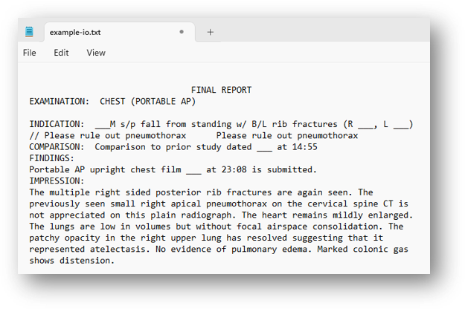
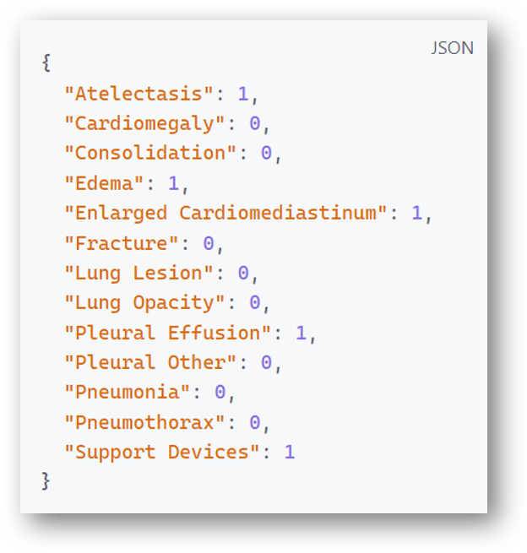
Task 2
Objective:
Develop a natural language processing model for multi-label classification of radiology reports from the MIMIC-CXR dataset, assigning each report up to 13 labels
Data:
MIMIC-CXR dataset with chest X-ray report and corresponding labels
Text Data
Multi-label Classification
Notes:
Thank you Sheryl.
I will present our task 2 on developing a natural language processing model for multi-label classification of radiology reports from the MIMIC-CXR dataset.
So, Our objective is to assign up to 13 labels to each report, identifying all these 13 conditions.

Slide 15
The Illusion of LLM
Fig. Pipeline of LLM Classification
CXR
Text
Report
No-Finding ?
CXR Text Report
Vote
（If finding）
No-Finding ?
No-Finding ?
With the chest x-ray reported above, do you think that the symptoms of {{pathology}}
13 pathologies
We tried with various models (llama3.2/1b, gpt-4o), but none of them worked well enough to avoid over-reasoning
Notes:
Initially, we explored LLM like Llama3.2 of 1b parameters and GPT-fourO as prediction model.
We also designed a complex process to give us more convincing results. We used, for example, polling and having LLM do multiple-choice questions for each type of pathology to reduce LLM's illusions.
But the results are still poor, LLM will always do some inaccurate over-reasoning making the accuracy of the prediction results very low.

Slide 16
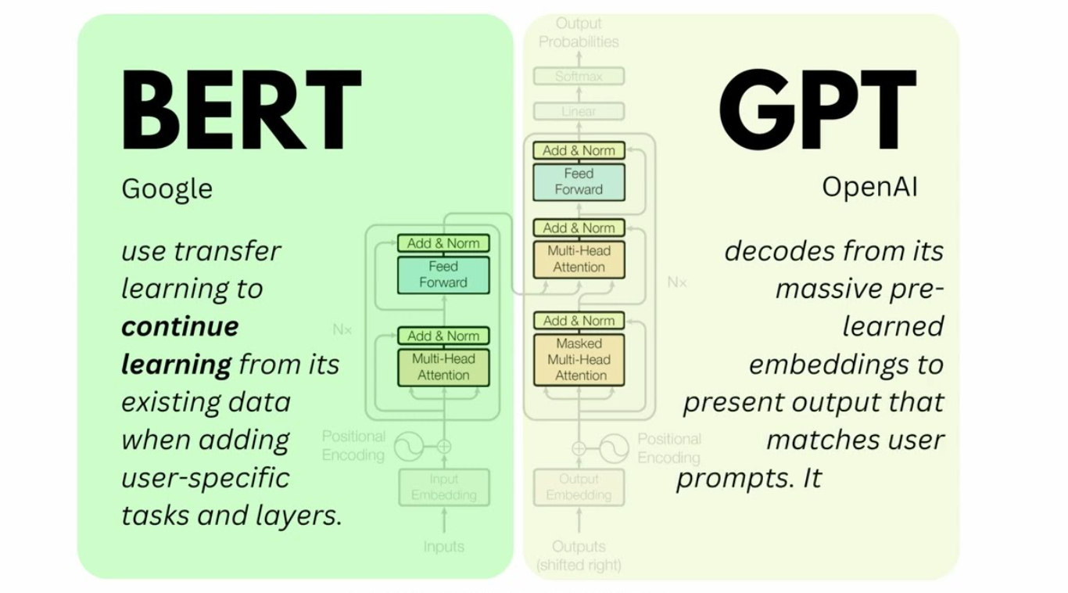
BERT vs GPT
Feature | BERT | GPT
Text Processing | Bidirectional Encoding | Unidirectional Generation
Pre-training Tasks | MLM + NSP (Understanding-Oriented) | Autoregressive Prediction (Generation-Oriented)
Suitable Tasks | Text Understanding, Classification | Text Generation
Task Fit | High (Context Understanding) | Low (Lacks Bidirectional Context Understanding)
Notes:
In radiology reports, pathological features may appear anywhere in the text. GPT's unidirectional nature can cause it to miss critical contextual clues, affecting classification accuracy.
GPT processes text only from left to right, predicting the next word, and cannot utilize contextual information from the right side.
Our research found that BERT performs better in such classification tasks.
BERT is a pre-trained language model based on the Transformer architecture, using a bidirectional encoder design. And BERT focuses on understanding tasks and, through fine-tuning, can perform classification more accurately without generating unnecessary content.

Slide 17
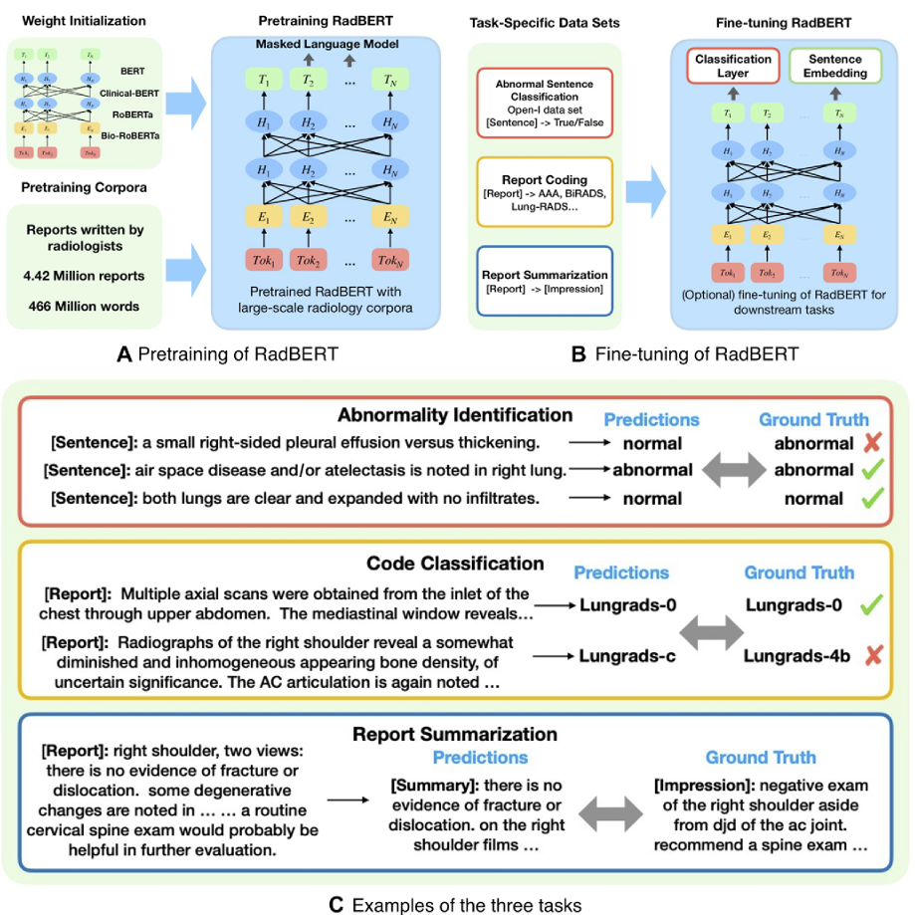
RadBERT
RadBERT-RoBERTa-4m is built based on the RoBERTa model.
Initial pre-training (RoBERTa initialization)
RoBERTa is a generalized pre-trained language model with initial weights derived from pre-trained datasets of RoBERTa. These datasets include:
BookCorpus
English Wikipedia
PubMed abstracts
BioMed papers
2. Domain-adapted training dataset
4 million VA hospital reports (U.S. Department of Veterans Affairs)
Notes:
Finally, we adopted RadBERT, a BERT variant tailored for radiology.
RadBERT leverages transfer learning, building on RoBERTa’s foundation and fine-tuning it on radiology-specific data.
The diagram illustrates BERT’s architecture, featuring multi-head attention and feed-forward layers, which enable the model to capture complex semantic patterns in medical texts.
This makes RadBERT an ideal choice for our classification task.

Slide 18
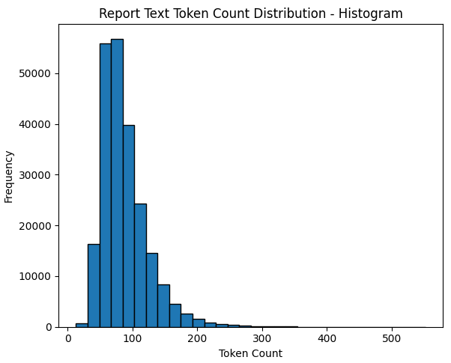
Data Preprocessing
Label Processing:
Removed the "No Finding" label; if "No Finding" is 1, set all 13 labels to 0; replaced missing and uncertain values with 0
Cleaning:
Used chardet to detect and correct encoding issues, ensuring accurate text loading.
Removed duplicate lines from reports to eliminate redundancy.
Tokenization and Formatting:
Applied AutoTokenizer to tokenize text, adding special tokens ([CLS], [SEP]), and padded or truncated sequences to a fixed length (512 tokens).
Converted tokens to IDs and generated attention masks.
Dataset Splitting:
Same split of data into training (50%), validation (30%), and test (20%) sets.
Notes:
After finalizing the model, we will process our data.
You can see our histogram.
Our data is text data that averages around 100 tokens.
For tokenization, we applied AutoTokenizer to add special tokens like [CLS] and [SEP], standardizing sequences to 512 tokens and generating attention masks.
The dataset was split into 50% training, 30% validation, and 20% testing.

Slide 19
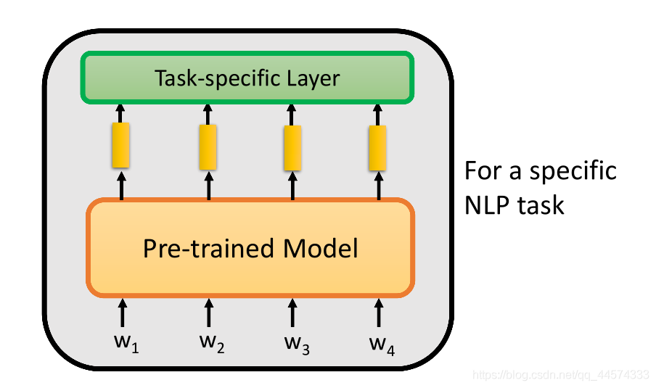
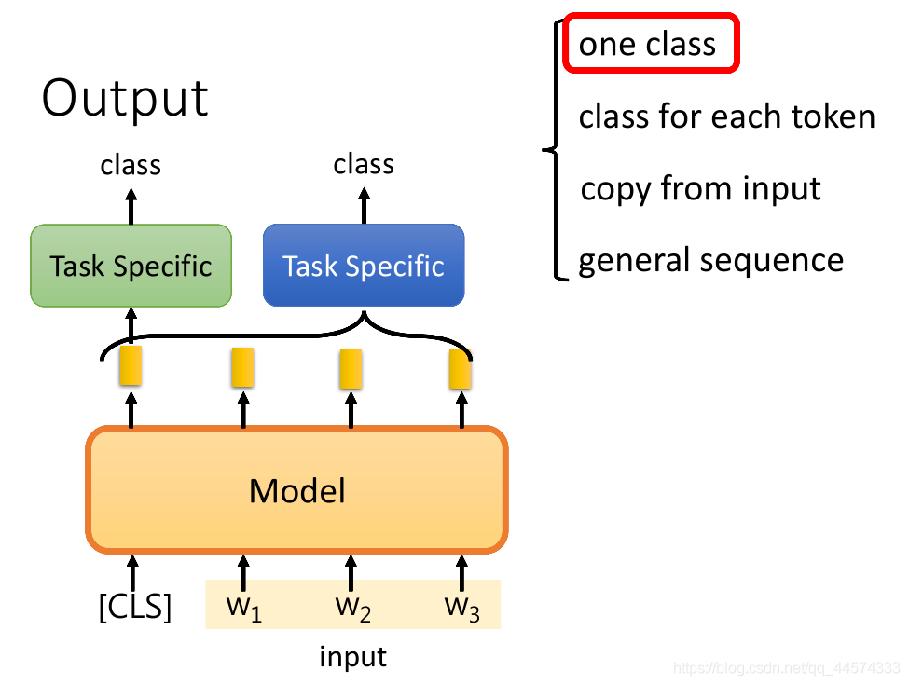
Fine-tuning RadBERT
RadBERT Original Objective:
RadBERT, a BERT variant designed for radiology, is pre-trained on Masked Language Modeling (MLM) to predict masked words in text.
Model Architecture:
Feature Extractor: Utilizes RadBERT’s BERT encoder (base_model.bert) to extract deep semantic representations from report texts.
Classification Head: Adds a linear layer to map the [CLS] token’s hidden state (dimension hidden_size, typically 768) to 13 logits (unnormalized prediction scores).
Model Training
Forward Pass: Input report text is processed by the RadBERT encoder to generate hidden states, with the [CLS] token representation fed into the classification head to produce 13 logits.
Loss Function: Employs BCEWithLogitsLoss (Binary Cross-Entropy with Logits), combining sigmoid activation and cross-entropy to optimize for multi-label classification.
Training Objective: Minimizes loss by comparing logits with true labels (0 or 1), adjusting model parameters.
Notes:
For fine-tuning RadBERT, we adapted its pre-trained Masked Language Modeling objective for classification.
The model uses RadBERT’s encoder as a feature extractor to derive deep semantic representations from report texts. A linear classification head maps the [CLS] token’s hidden state to the 13 labels.
We trained using binary cross-entropy loss and the AdamW optimizer, monitoring validation loss to prevent overfitting. This setup ensured robust performance on our multi-label task.

Slide 20
Result
Label ​ | ROC AUC ​ | Precision (Positive) ​ | Recall (Positive) ​ | F1-score (Positive) ​
Atelectasis ​ | 0.9979 ​ | 0.99 ​ | 0.97 ​ | 0.98 ​
Cardiomegaly ​ | 0.9986 ​ | 0.98 ​ | 0.99 ​ | 0.99 ​
Consolidation ​ | 0.9967 ​ | 0.99 ​ | 0.94 ​ | 0.96 ​
Edema ​ | 0.9983 ​ | 0.98 ​ | 0.99 ​ | 0.98 ​
Enlarged Cardiomediastinum ​ | 0.9957 ​ | 0.93 ​ | 0.93 ​ | 0.93 ​
Fracture ​ | 0.9974 ​ | 0.96 ​ | 0.94 ​ | 0.95 ​
Lung Lesion ​ | 0.9982 ​ | 0.96 ​ | 0.96 ​ | 0.96 ​
Lung Opacity ​ | 0.9982 ​ | 0.99 ​ | 0.98 ​ | 0.98 ​
Pleural Effusion ​ | 0.9986 ​ | 0.99 ​ | 0.99 ​ | 0.99 ​
Pleural Other ​ | 0.9942 ​ | 0.99 ​ | 0.95 ​ | 0.97 ​
Pneumonia ​ | 0.9949 ​ | 0.95 ​ | 0.91 ​ | 0.93 ​
Pneumothorax ​ | 0.9973 ​ | 0.99 ​ | 0.95 ​ | 0.97 ​
Support Devices ​ | 0.9979 ​ | 0.99 ​ | 0.99 ​ | 0.99 ​
ROC AUC Scores:
Each label's ROC AUC exceeds 0.97, with the highest being "Pleural Other" (0.9999) and the lowest "Pneumonia" (0.9772).
The macro-average ROC AUC is 0.9926, indicating the model's extremely high classification ability across all 13 labels.
Classification Report:
For common labels (e.g., "Atelectasis," "Pleural Effusion"), precision and recall are close to 0.98-0.99.
For rare labels (e.g., "Enlarged Cardiomediastinum"), recall is slightly lower (0.93), but overall accuracy remains high.
The weighted average F1 score is close to 0.99, reflecting the model's adaptability to imbalanced data.
Notes:
Now, let’s see the results. Our model performed exceptionally well on the test set.
ROC AUC scores exceeded 0.97 for all labels. The macro-average ROC AUC was 0.9926, reflecting strong classification ability.

Slide 21
Discovery: The more, the merrier
Fig. Enlarged Cardiomediastinum
Test Result (30000 Sample)
Fig. Enlarged Cardiomediastinum
Test Result (Full Dataset)
Class | Precision | Recall | F1-Score | Support
Negative | 0.99 | 1.00 | 0.99 | 5811
Positive | 0.87 | 0.65 | 0.75 | 189
Accuracy |  |  | 0.99 | 6000
Macro Avg | 0.93 | 0.82 | 0.87 | 6000
Weighted Avg | 0.99 | 0.99 | 0.99 | 6000
Class | Precision | Recall | F1-Score | Support
Negative | 1.00 | 1.00 | 1.00 | 44,140
Positive | 0.93 | 0.93 | 0.93 | 1,426
Accuracy |  |  | 1.00 | 45,566
Macro Avg | 0.97 | 0.96 | 0.96 | 45,566
Weighted Avg | 1.00 | 1.00 | 1.00 | 45,566
We initially trained the model on 30,000 samples, and the classification performance for ‘Enlarged Cardiomediastinum’ was suboptimal.
However, after training on the full dataset (220,000+) the performance improved significantly.
Notes:
An interesting finding was the impact of dataset size.
When trained on 30,000 samples, the model’s performance on “Enlarged Cardiomediastinum” was suboptimal, with an F1 score of 0.75, as shown in the left table.
However, training on the full dataset of over 220,000 samples significantly improved results, boosting the F1 score to 0.93, as seen in the right table.
So we believe that our model is able to make more accurate predictions when it has enough data

Slide 22
In conclusion -
Automating detection of clinical findings with traditional classifiers and neural networks would require additional time and resources to optimise
Facilitating the extraction of common clinical findings from report notes with natural language processing may be more achievable and impactful on radiologists' workload
Notes:
The automation of the detection of clinical findings using the classifiers would require more time and resource for us to optimize，but at this point of time，facilitating the extraction of the 13 clinical findings from the report notes using natural language processing such as radbert, would be more achievable and impactful, and radiologists would load as these would take some time of their current practice. This is the the end of our presentation. Thank you for listening.

Slide 23
Thank you

Slide 24
Additional slides

Slide 25
Model Hyperparameters
Model | Hyperparameters tested
Logistic regression | -
Logistic regression with L1 regularization | -
Logistic regression with L2 regularization | -
Elastic net regression | Alpha: [0.3, 0.5, 0.7]
Support vector machine | Kernel: [polynomial, radial basis function (RBF)] C score: [0.1, 0.5, 1, 10]
Random forest | N estimators: [200] Max depth: [15] Class weight: ['balanced']
xgBoost | Max depth: [3, 5, 7], Learning rate: [0.01, 0.1, 0.2], N estimators: [50, 100, 150]
Fully-connected neural network (4 layers) | Learning rate: [0.01, 0.1, 0.2] Dropout rate: [0.2, 0.5]
Transformer | Focal loss α: 0.75 Focal loss γ: 2 Hidden dimension: 512 Attention head: 8 Embedding sequence length: 8

Slide 26
Task 1 - Overall Model Results (macro average)
Model | Precision | Recall | F1-Score
Logistic regression | 0.24 | 0.20 | 0.20
L1 regularization | 0.31 | 0.09 | 0.13
L2 regularization | 0.31 | 0.09 | 0.12
Elastic net | 0.31 | 0.09 | 0.13
Support vector machine | 0.31 | 0.07 | 0.09
Random forest | 0.26 | 0.40 | 0.31
xgBoost | 0.37 | 0.10 | 0.14
Fully connected neural network | 0.15 | 0.67 | 0.23
Transformer | 0.27 | 0.31 | 0.28

Slide 27
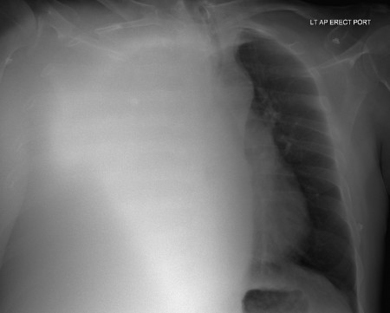
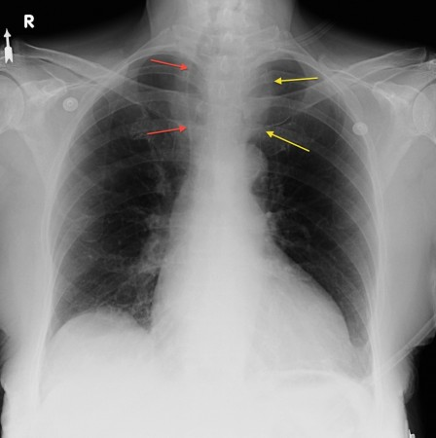
Some conditions are more subtle than others and perhaps need radiologist interpretation
Pleural effusion
Enlarged cardiomediastinum

Slide 28
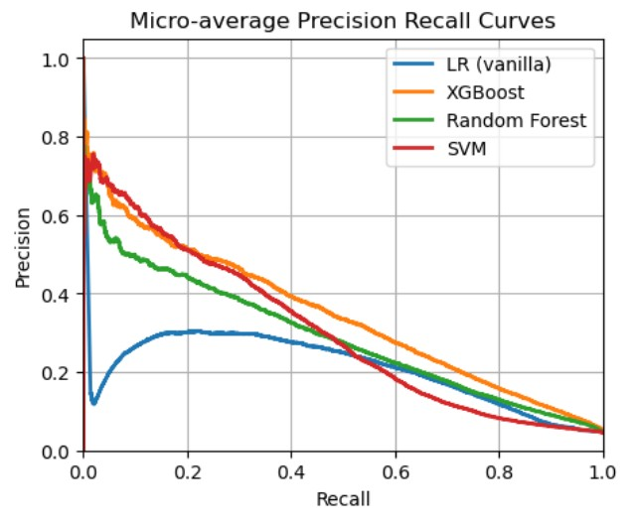
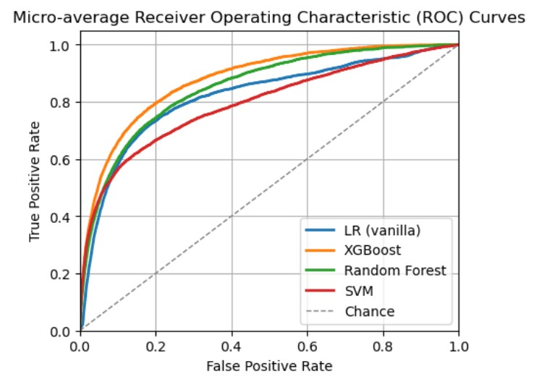
PR and ROC curves of traditional classifiers

Slide 29
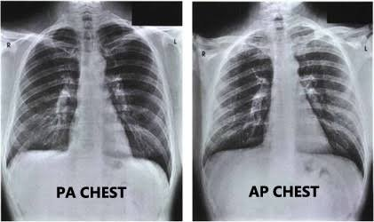
Would providing additional information, e.g. scan view improve performance?
Notes:
The choice of AP vs PA view might tell us about what conditions the patient has, or what the physician is looking out for. For example, in PA chest X-rays, the heart is closer to the X-ray detector therefore providing the true heart size, whereas in AP chest X-rays, the heart is magnified and could be misinterpreted as cardiac enlargement.
https://www.radiologymasterclass.co.uk/tutorials/chest/chest_quality/chest_xray_quality_projection

Slide 30
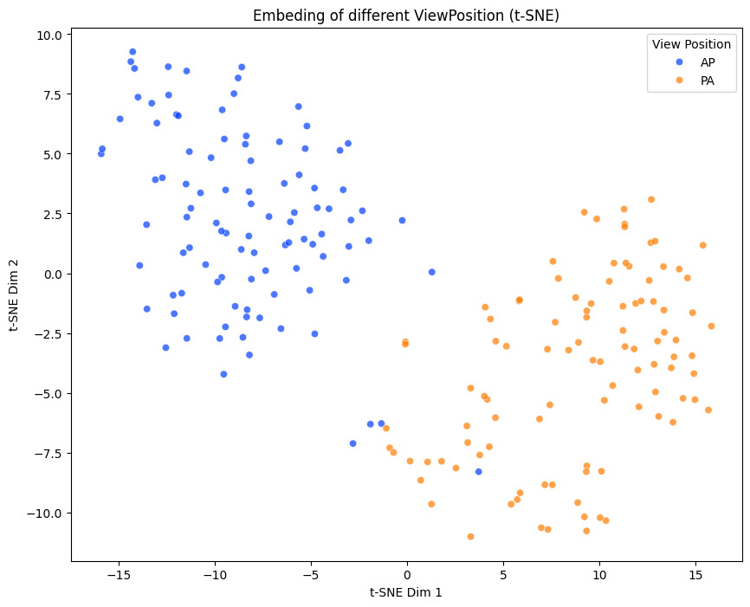
The scan view is already captured in the embedding data

Slide 31
Transformer architecture
Input: original vectors of (batch size, 1376) reshape as (batch size, 8, 172)
Input Projection: The 172-dimensional vector at each split is projected into a 512-dimensional latent space by a linear layer
Transformer Encoder: Models the information for each split with self-attention
Attention Pooling: Input an attention score for each split
Softmax normalization for weights
Calculated weighted sum for all splits
Output: Simple feedforward network to obtain logits (batch size, 13)
Original input dimension
Embedding split length
Number of features in each split
Category

Slide 32



Transformer architecture
Focal Loss: α (weight for positive samples): 0.75 γ (focusing parameter): 2
In the transformer model, we have , where:
The probability of predicting the correct category

